Slide 1

Chapter 1 & 2
The R Environment(IPSUR)
&
An Introduction to R (SEEFELD
Mr. Matthew Wayne Valentine
CAMS - Office 1.32
Lab K2 – Tech Room K2
mvalentine@uwc.ac.za

Slide 2
Content
Downloading and Installing R
Installing and Loading Add-On Packages
Communication with R
Exploring the Environment
Getting Help in R
Textbooks Used

Slide 3


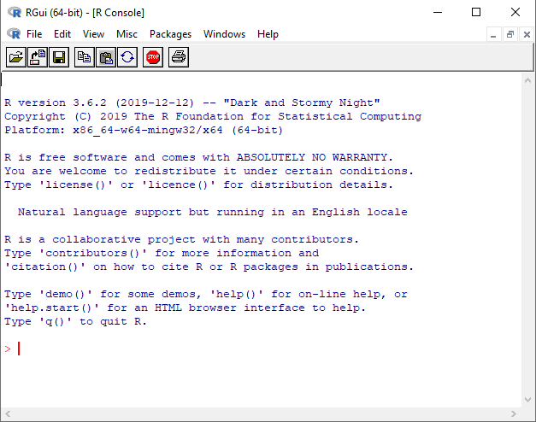
Exploring the Environment
When starting up R the screen will look like this. There is a main application window and within it is a console window. The main application contains a menu bar with 7 menus and toolbar with 8 icons for basic tasks.
The command line is where you interact with R. The symbol “>” is where you write code. Eg; Mathematical Calculations.

Slide 4
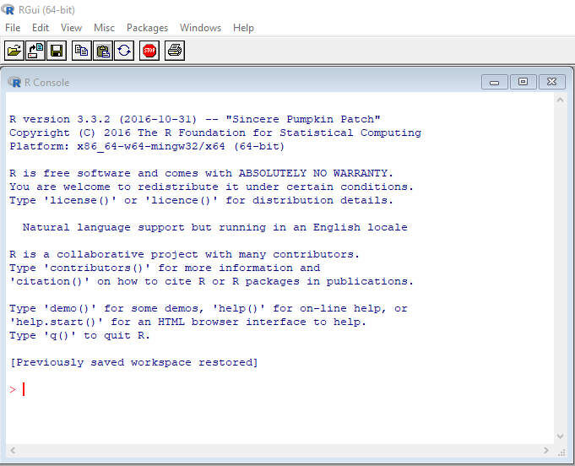
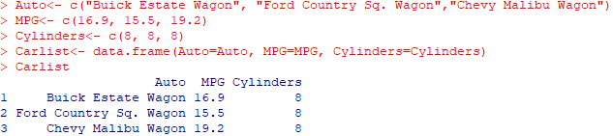
Exploring the Environment
The Menu Bar
File – it contains options for opening, saving and printing R documents as well as exiting the program. (Also Use the Close Button )
The options that begins with load allows one to open previously saved work. Eg; Load Workspace and Load History
Edit – This menu contains standard functions such as cut, copy, paste and select all. In addition there's a clear console, which clears all code that has been written. Although if any assignments were made to objects it will remain in the memory. The data editor option, a spreadsheet like interface for manual editing. Gui Preferences opens the Rgui configuration editor, allowing one to set options controlling the GUI such as font and size.
Misc – This feature allows one to stop current computation, if one decides to program a loop and it loops continuously, the ESC function will be able to stop it and return you to the command line.

Slide 5
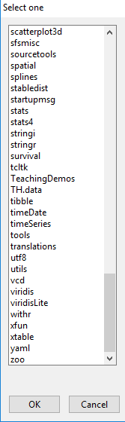
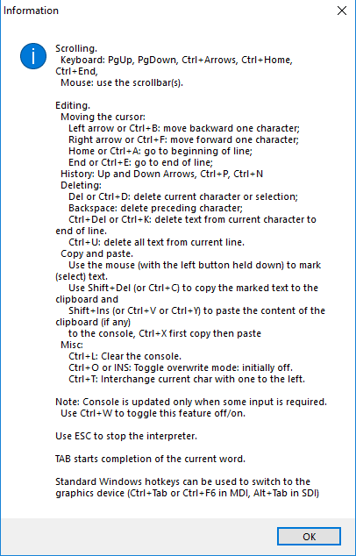
Exploring the Environment
Packages – This is a very important function, instead of writing code to load and install a package, the package menu does it for you. You would only have to choose a package you would want to load and install.
Windows – The windows menu provides one with options to set up the console and script editor in cascade or tilling windows.
Help – Provides you with various sources of help and warrants and exploration. It also provides you with information listing shortcuts and keystrokes.
Frequently asked questions, HTML documents for R and R operating System you are using. These can be obtained without an internet connection.
R Language (Standard), “R language (HTML)”, and “Manuals” are found here as well. The R Language (Standard) once clicked a dialog box appears which allows one to type in a term that you would like to gain more information about.

Slide 6
Exploring the Environment
The Toolbar
The toolbar provides you with quick and easy access to the most used options in the Menu Tab.
If you hover over one of the toolbar items you will see the items name.
To Reiterate, the Stop button in the toolbar allows you to stop current computation immediately.

Slide 7
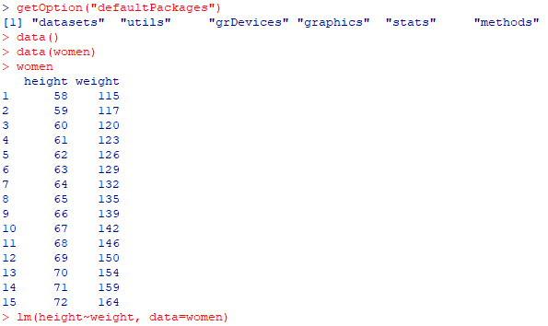
How R Works
R is an interpreted Language, not a compiled one which means that all the code that you write are executed without requiring to build a complete program.
R Syntax is simple and intuitive. A linear regression can be done with the following command lm(y~x) whereby y is your response variable and x is your predictor variable.
In order for code to be executed, it always needs a function that should be written in Parentheses, even if there is nothing written between them ls(). Which will display the content of the function. Eg; displays the objects you have stored. You can also use rm() to delete an object.
When R is running variables, data, functions or results it is stored in its active memory of the computer in the form of objects which has a name.
The user can do actions on these objects with operators (Arithmetic or logical) and functions which are objects themselves.

Slide 8


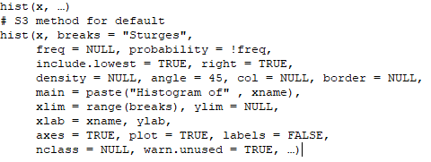
How R Works
Functions are created using the function() directive and are stored as R objects just like anything else. In particular, they are R objects of class “function”.
Functions have named arguments which potentially have default values. The formal arguments are the arguments included in the function definition. Not every function call in R makes use of all the formal arguments

Slide 9
Getting Help
Console: gives useful shortcuts, for instance, Ctrl+L, to clear the R console screen.
FAQ on R: frequently asked questions concerning general R operation.
FAQ on R for Windows: frequently asked questions about R, tailored to the Microsoft
Windows operating system. If you have downloaded R on a different operating system then it will be tailored to your system.
Manuals: technical manuals about all features of the R system including installation, the complete language definition, and add-on packages.
R functions (text) : use this if you know the exact name of the function you want to know more about, for example, mean or plot. Typing mean in the window is equivalent to typing help("mean") at the command line, or more simply, ?mean.
HTML Help: use this to browse the manuals with point-and-click links.

Slide 10
Downloading and Installing R
It’s Open Source – therefore it’s FREE.
R largely depends on the users hardware and operating system.
R comes with a written installation and administration manual with complete instructions and additional information on how to install R.
Installing R
These are a few Links in which one can download R software for a specific users operating system.
MicrosoftWindows: https://cloud.r-project.org/bin/windows/
MacOS: https://cloud.r-project.org/bin/macosx/
Linux: https://cloud.r-project.org/bin/linux/

Slide 11
Installing and Loading Add-on Packages
R comes with base packages which are created and maintained by a select group of individuals known as “R-Core”.
There are also additional packages written by thousands of people who contribute to base packages all of the world.
These packages are stored on Mirrors of the Comprehensive R Archive Network Known as “CRAN”.
These base packages can only be accessed with an internet connection.
In order to see what base packages R has as the default;
Type “getOption("defaultPackages")” within R GUI.
In order to obtain more information regarding installation of R and Add-on Packages; click on the Hyperlink Provided: http://cran.r-project.org/manuals.html.

Slide 12
Communication With R
For beginners, code will be written in one line at a time within RGui (Microsoft Windows)
R-Editor (Windows Microsoft): RGui has its on built in Script Editor known as the R-Editor.
Open RGui – Select (Ctrl+L) – Type the code “getOption(“defaultPackages”)”.
Many lines of code can be written in a script, which cannot be done in the R console can be done as follows;
In the console window select (File and then New Script). This opens up a new editor window in which code can be written in a new script.
Once the code has been written you can automatically run all your code by selectin (Ctrl+R)

Slide 13
Textbooks Used
There are 4 textbooks that will be used throughout the course.
Here are the hyperlinks provided below;
These need to be downloaded and studied as instructed for further tests and assignments.
Seefeld: https://cran.r-project.org/doc/contrib/Seefeld_StatsRBio.pdf
IPSUR: https://cran.rproject.org/web/packages/IPSUR/vignettes/IPSUR.pdf
R-Intro: https://cran.r-project.org/doc/manuals/r-release/R-intro.pdf
R-Import: https://cran.r-project.org/doc/manuals/r-release/R-data.pdf

Slide 14
Study
Chapter 1 & 2
The R Environment
&
An Introduction to R
(IPSUR and SEEFELD)
Matthew Wayne Valentine
Office 1.32
Lab K2 – Tech Room K2
mvalentine@uwc.ac.za

